Slide 1

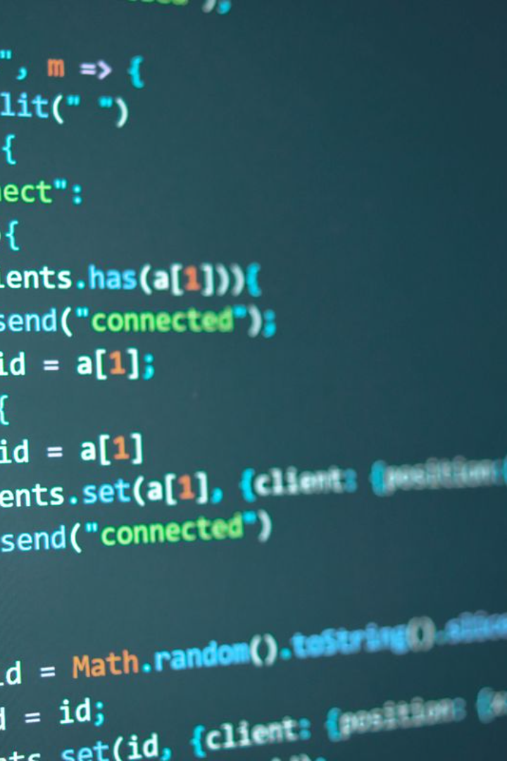
Variables and Constants in C Language
Learn about variables and constants in the C programming language. Understand their importance and how to declare, initialize, and use them in your programs.

Slide 2

Rules for Writing Variable Names in C
Variable names play an important role in programming. They should be chosen carefully and follow certain rules. Some of the common rules for writing variable names in C include starting with a letter or underscore, using only letters, numbers, and underscores, and avoiding reserved words. Good variable names can make your code more readable and easier to understand.

Slide 3
Valid and Invalid Variable Names in C
Valid Variable Names
Invalid Variable Names
Examples of valid variable names in C:
Examples of invalid variable names in C:
count
123var
myVariable
my-variable
user_input
@name

Slide 4

Variables in C Language
1
Dynamic Storage
2
Data Manipulation
Variables allow for efficient memory allocation and dynamic storage of values while the program is running.
With variables, you can easily manipulate and modify data during program execution.

Slide 5

Constants in C Language
1
Fixed Values
2
Data Security
Constants represent fixed values that cannot be altered during program execution.
Using constants ensures that important values remain unchanged throughout the execution of the program.

Slide 6

Declaring and Initializing Variables
1
Syntax
2
Example
Declare variables by specifying the data type followed by the variable name. Initialize variables by assigning them a value.
int age; // Declaration
age = 25; // Initialization

Slide 7

Using Variables in Expressions
1
Arithmetic Operations
2
Example
Perform calculations using variables to dynamically manipulate data and obtain desired results.
int x = 10, y = 5, sum;
sum = x + y; // Addition

Slide 8
Example: Simple Program using Variables in C Language
Code
Output
#include <stdio.h>
The area of the circle is 78.5
int main() {
int radius = 5, float area;
area = 3.14 * radius * radius;
printf("The area of the circle is %f", area); return 0; }

Slide 9
Example: Simple Program using Constants in C Language
Code
Output
#include <stdio.h>
The area of the circle is 78.5
#define PI 3.14
int main() {
int radius = 5, float area;
area = PI * radius * radius;
printf("The area of the circle is %f", area); return 0; }

Slide 10
Summary and Conclusion
Variables
Constants
Use Case
Variables allow for dynamic storage and manipulation of data in C language.
Constants provide fixed values that remain unchanged throughout the execution of a program.
Choose variables or constants based on whether you need data manipulation or fixed values in your program.

